Slide 1
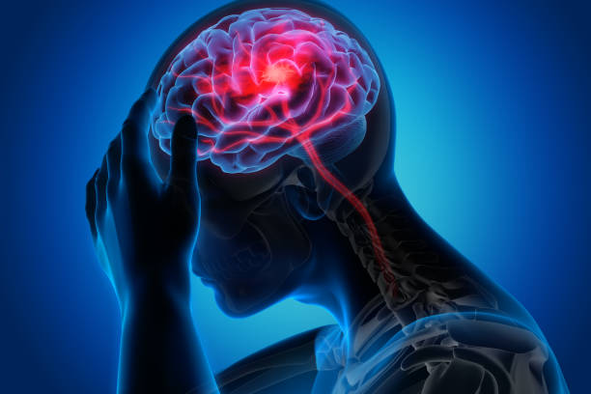
Stroke Prediction
Presented By:
Shubham Shedekar
PRN: - 22070243045

Slide 2
Objectives
Develop a machine learning-based stroke prediction model using various classification algorithms
Evaluate the performance of the developed model using various algorithms.
Perform feature selection and analysis to identify the most significant factors affecting stroke risk
Provide insights into stroke prediction and prevention, and the potential clinical applications of the developed model

Slide 3
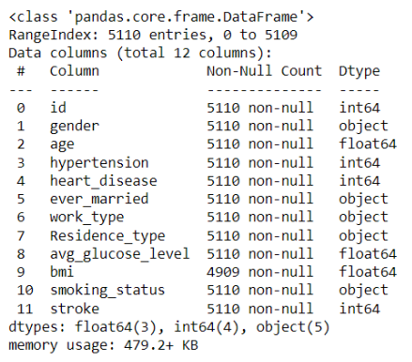
INTRODUCTION
Dataset Name : - Stroke Prediction
Dataset Rows : - 5510
Dataset column : - 12
Data types : - int64, float, object

Slide 4


Exploratory data Analysis
Missing Values: -
Handling Missing Values : -
There are 201 missing values in the dataset So we can fill this missing value with mean.

Slide 5
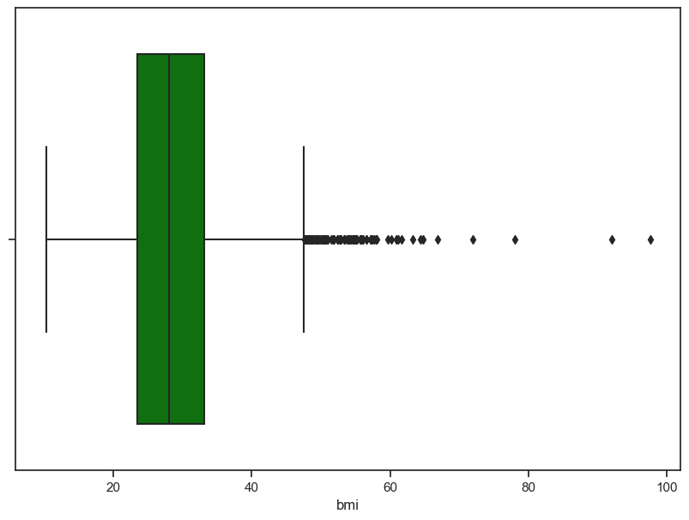
Handling the outliers
This graphs tells us that threre is some outliers values which are present in the dataset.
So we can try to remove this outliers by using lambda function

Slide 6
Use of psycopg2 for connection
Make connection with the database with the help of psycopg2 library
First created the table in database and then add the excel file in it.
After that fetch all the data and to further analysis

Slide 7
Visualization
Libraries used for visualisation
matplotlib
seaborn
plotly
Graphs plot
Histogram
pie chart
Scatterplot
Boxplot

Slide 8
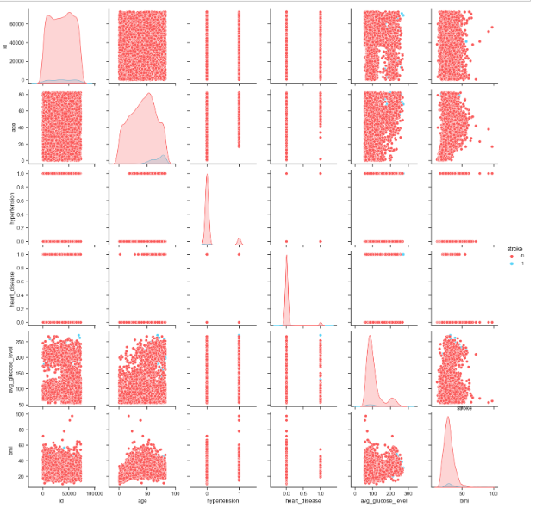
Pairplot
Pair plot is used to understand the best set of features to explain a relationship between two variables or to form the most separated clusters

Slide 9
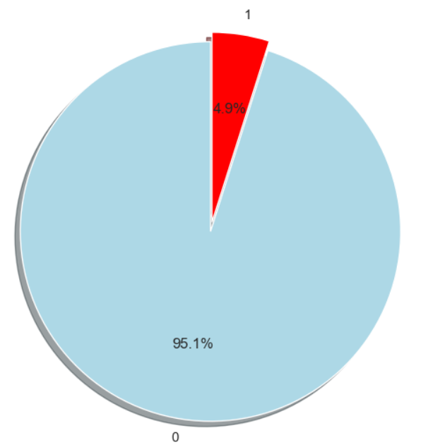
Visualization
This graph is of percent of people having stroke or not
This pie chart tells that 4.9% of people having the strike and 95% pf people are not having stroke

Slide 10
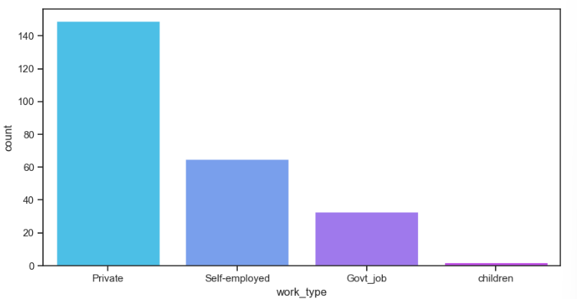
Visualization
This graph Visualize the work types of the patients
Here the more patient are in private job and less people in government job.

Slide 11
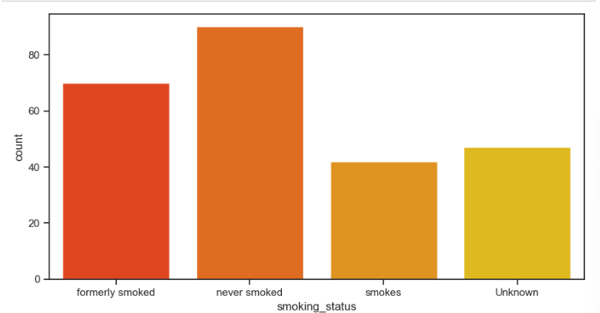
Visualization
This Graph is of smoking status of the patients
Here more patient are in no smoker category.

Slide 12
Machine Learning
Splitting the data into train test
Data Was divided into train and test so that it will help us to run machine learning model
The split was taken into 7:3 (means the test size is 30 % and training size is 70 % of the data)

Slide 13
Machine Learning
Splitting the data into train test
Random forest classifier: - Random forest classifier is used to train machine learning and guve the accuracy of 0.953033
Logistic Regression :- Logistic regression is dome and give accuracy of 0.95564
Decision Tree: Decision Tree classifier is used and get the accuracy of 0.913242

Slide 14
Conclusion
Machine learning models can accurately predict the likelihood of stroke occurrence based on various risk factors such as age, hypertension, smoking, and heart disease.
The accuracy of the prediction models can be improved by increasing the sample size, optimizing the model's hyperparameters, and using more sophisticated algorithms such as deep learning.
The use of electronic health records and other medical data sources can help identify
patients who are at high risk of stroke, allowing for early intervention and prevention

Slide 15
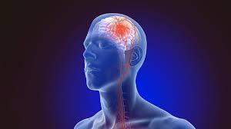
Thank You

